Slide 1
Gamification
Design presentation

Slide 2
IntroDuction
This project is to develop a web application for the gamification of big data. The data that will be analyzed is data received from an inventory software, which keeps inventory of equipment that is used by teams. These teams should utilize the inventory software whenever they have jobs. Check if inventory is being returned. The data will be analyzed, and a scoring system will rank the teams, based on how much they utilized the software and if their equipment was returned. This will increase productivity.

Slide 3
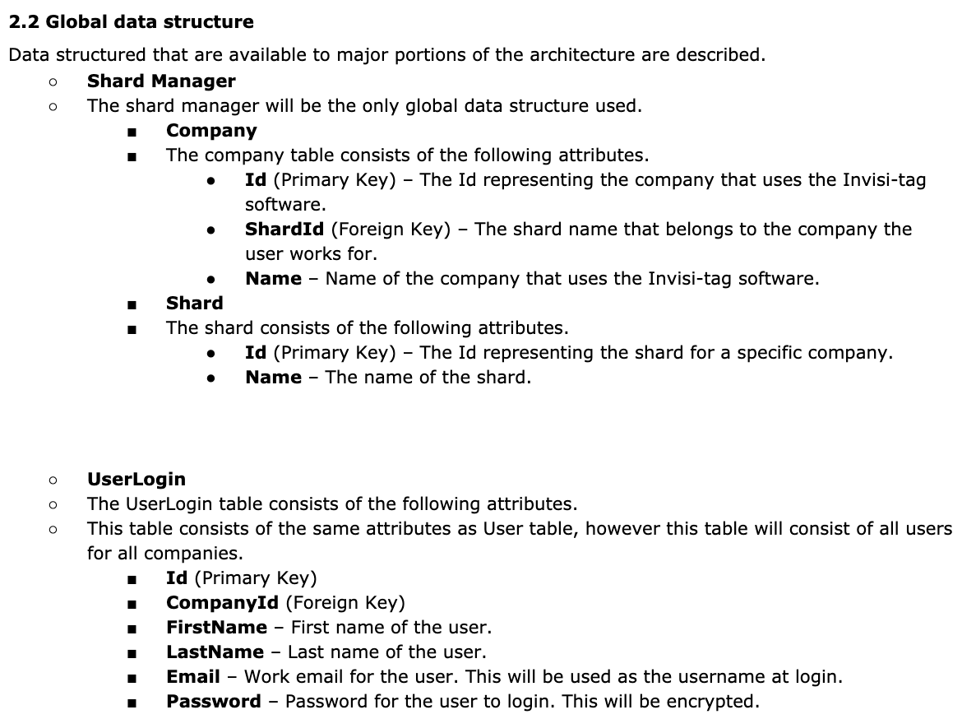
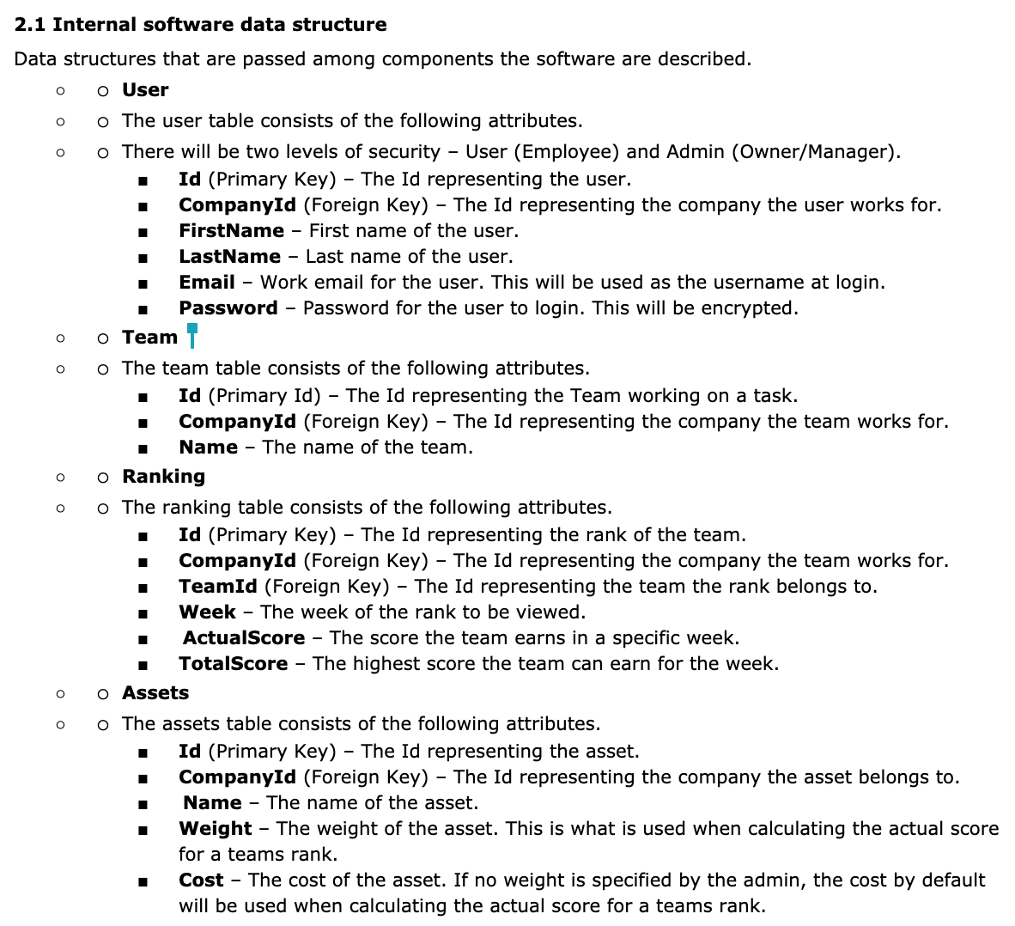
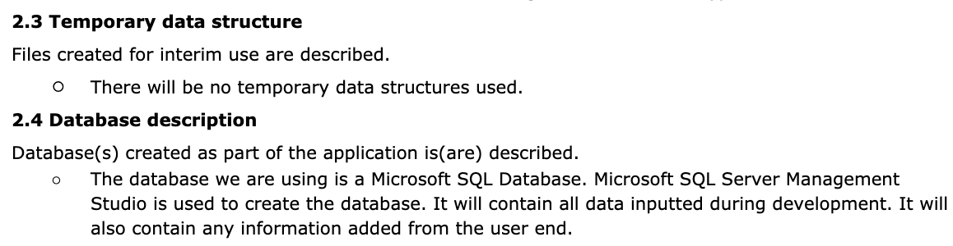
Data Design
Notes:
For our internal data structures we have the following tables User, team, ranking, and assets.
For our global data structures we have the shard manager which contains the company table and shard table.
And we also have the user login table which consists of the same attributes as the user table but will contain all users for all companies.
There will be no temporary data structures.
The database we are using is a microsoft sql database. Microsoft SQL server management studio is used to create the database. It will contain all data inputted during development and it will also contain any information added from the user end.

Slide 4
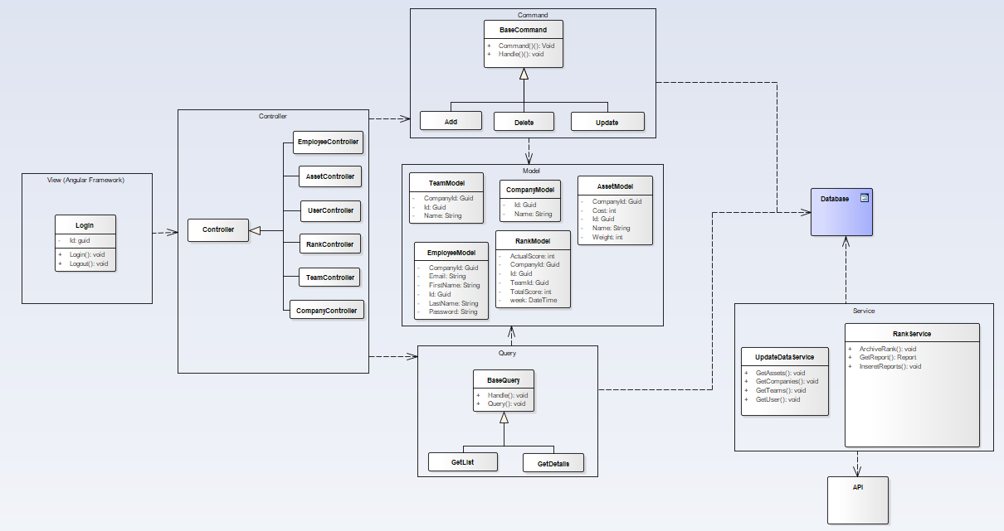
Architectural and component-level design

Slide 5
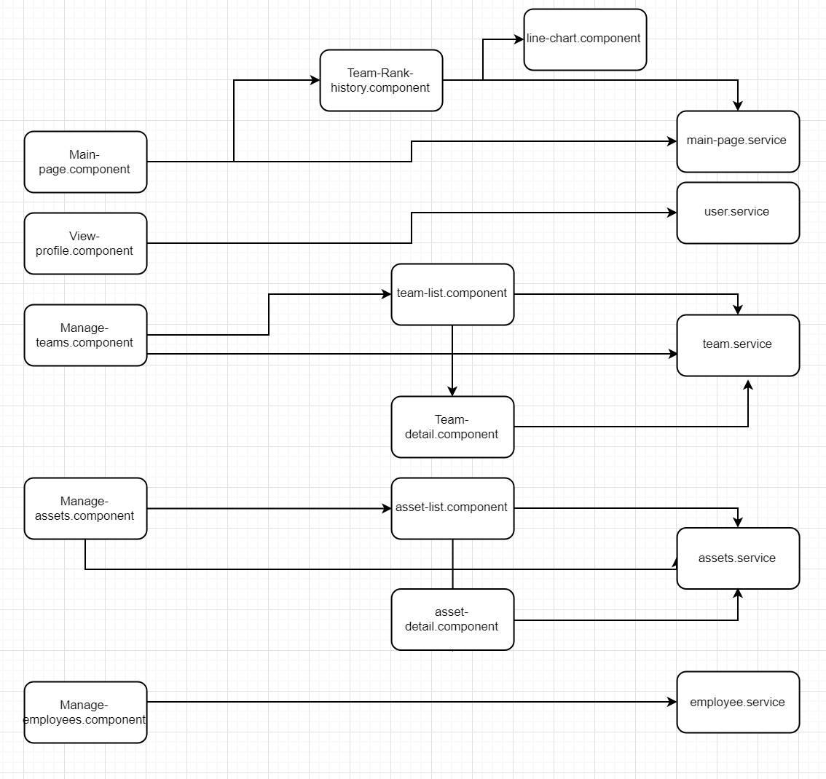
Architectural and component-level design

Slide 6

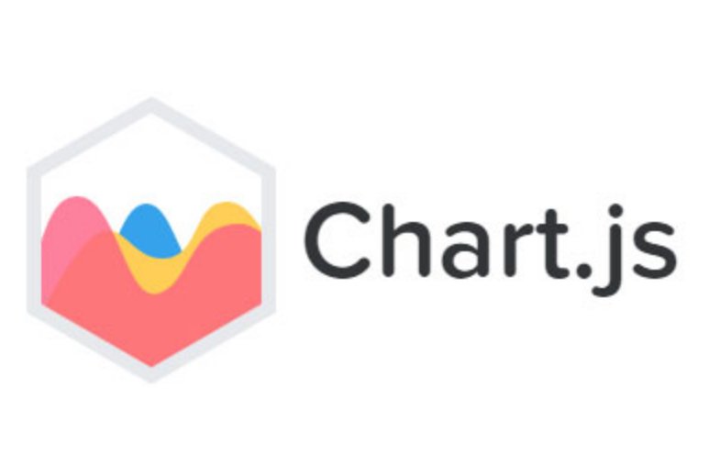


Interface Design
Notes:
Design rules were mainly focused towards the user. Giving the user a friendly intuitive interface
Kept everything consistent through the design, if the header of a row is clickable in one table it must behave the same way for all the other tables in the website. That way the user will not be confused or left guessing on the use of a functionality.

Slide 7
Restrictions, limitations, and constraints
Limitations:
We are creating the gamification web-application to fit the client's current software. Using the clients Api we can pull information, but we are limited to how the client’s software is designed. There software was not initially created with this feature in mind. The client only allows you to retrieve job reports for a start date not an end date, the jobReport/tags(assets used on a report) api does not have the tagUUID instead it has a tag RFID meaning that during creation we will have to save both creating an extra unused column. The other IDS for entities work understandably as of now.
Constraints:
database should be sharded, each shard should contain only one company. The shards are completely independent of each other. This will remove previous set constraints but add new ones. The shard manager should direct users and the system to the correct database shard.

Slide 8
Demo

